Slide 1

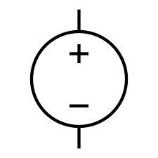
TB6560 DRIVER
CLK+
DIR+
+24V
GND
A
Ā
B
Ḇ
TM4C123GXL
ROT. ENCODER
UART1 CTS (PF1)
UART1 RTS (PC4)
UART1 RX (PB0)
UART1 TX (PB1)
QEI0 PhaA (PD6)
QEI0 PhaB (PD7)
QEI1 PhaA (PC5)
QEI1 PhaB (PC6)
PWM0 (PB6) GPIO0 (PE1)
GPIO1 (PD1)
GPIO2 (PD2)
GPIO3 (PD3)
+5V
+3.3V
GND
PhaA
PhaB
+5V
GND
12V
24V
TB6560 DRIVER
ROT. ENCODER
CLK+
DIR+
+24V
GND
A
Ā
B
Ḇ
PhaA
PhaB
+5V
GND

